Slide 1


www.ic-c.com.hk 2026 I- CONCEPT CONSULTATION LIMITED. ALL RIGHTS RESERVED +852 52493213
EVENT PRODUCTION EVENT MANAGEMENT MARKETING CAMPAIGN

Slide 2
BRAND DIRECTION
Personalised Glow Keepsake Workshop
專屬閃耀紀念工作坊
CT AFF Workshop · Hands-on beauty/lifestyle workshop activation
A
B
C
RECOMMENDED HERO ROUTE
PRODUCT / EXPERIENCE
MEDIA / PR
Glow Keepsake Atelier / 閃耀紀念工坊
Crystal Glow Lab / 晶亮光影實驗室
Initials & Icons Gift Bar / 專屬字母禮物吧
This route turns the workshop into a Charlotte Tilbury-style keepsake atelier: guests build a small illuminated sand-art object, choose colours and a…
This route makes the illuminated version the hero and frames the workshop as a glow-and-texture lab. The experience feels more premium because guests…
This route prioritises throughput and guest satisfaction: the workshop becomes a guided gift bar where every participant leaves with a personalised o…
I-CONCEPT · INTERNAL DRAFT — HUMAN REVIEW REQUIRED

Slide 3
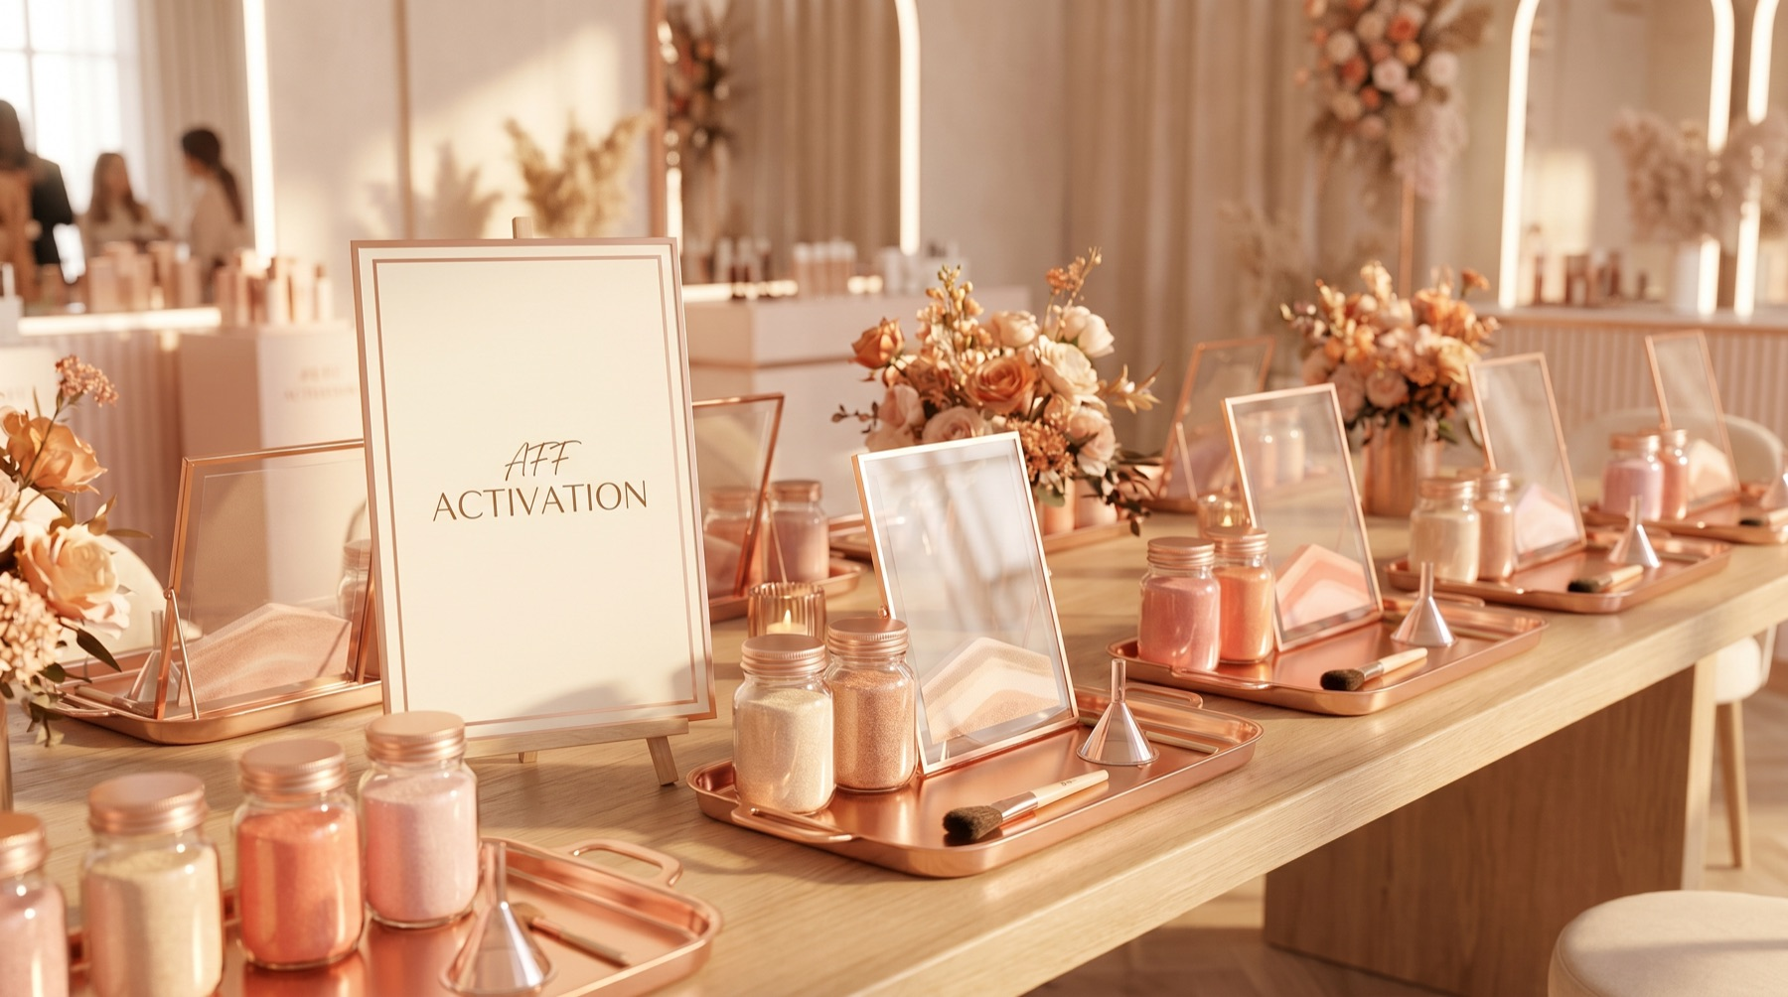
DIRECTION A
Glow Keepsake Atelier / 閃耀紀念工坊
This route turns the workshop into a Charlotte Tilbury-style keepsake atelier: guests build a small illuminated sand-art object, choose colours and accessories, then finish it with rose-gold initials. It wins because the existing proposal…
KEY ZONES
• Atelier welcome table with rose-gold…
• Personalisation workbench where guest…
• Illuminated reveal display showing fi…
• Care-card and packaging moment explai…
I-CONCEPT · INTERNAL DRAFT — HUMAN REVIEW REQUIRED

Slide 4
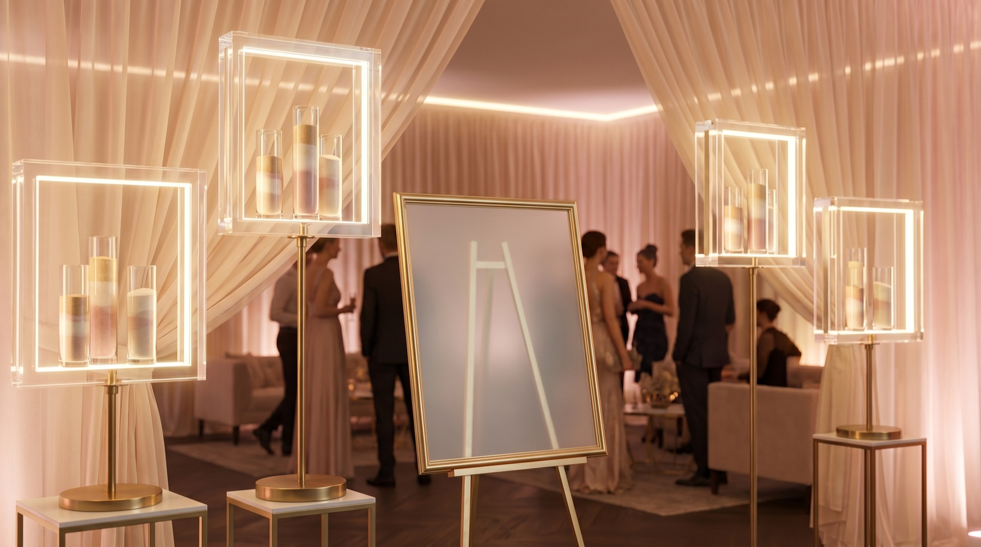
DIRECTION B
Crystal Glow Lab / 晶亮光影實驗室
This route makes the illuminated version the hero and frames the workshop as a glow-and-texture lab. The experience feels more premium because guests see sand colour, floating oil, acrylic tools, and light working together instead of only…
KEY ZONES
• Glow sample bar comparing illuminated…
• Colour and texture lab with labelled…
• Light-test reveal corner where each g…
• Operations back table for glue, wet w…
I-CONCEPT · INTERNAL DRAFT — HUMAN REVIEW REQUIRED

Slide 5
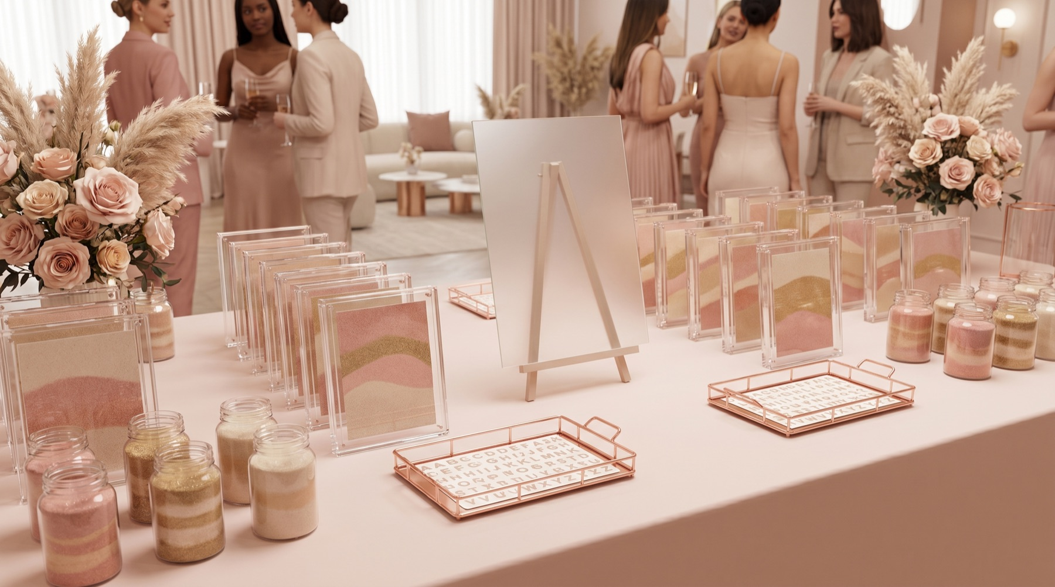
DIRECTION C
Initials & Icons Gift Bar / 專屬字母禮物吧
This route prioritises throughput and guest satisfaction: the workshop becomes a guided gift bar where every participant leaves with a personalised object that feels ready to present. It wins if the AFF setting needs a compact, easy-to-exp…
KEY ZONES
• Choice counter with frame option samp…
• Guided assembly lane moving guests th…
• Rose-gold initials station with acryl…
• Finished gift photo shelf with take-h…
I-CONCEPT · INTERNAL DRAFT — HUMAN REVIEW REQUIRED

Slide 6
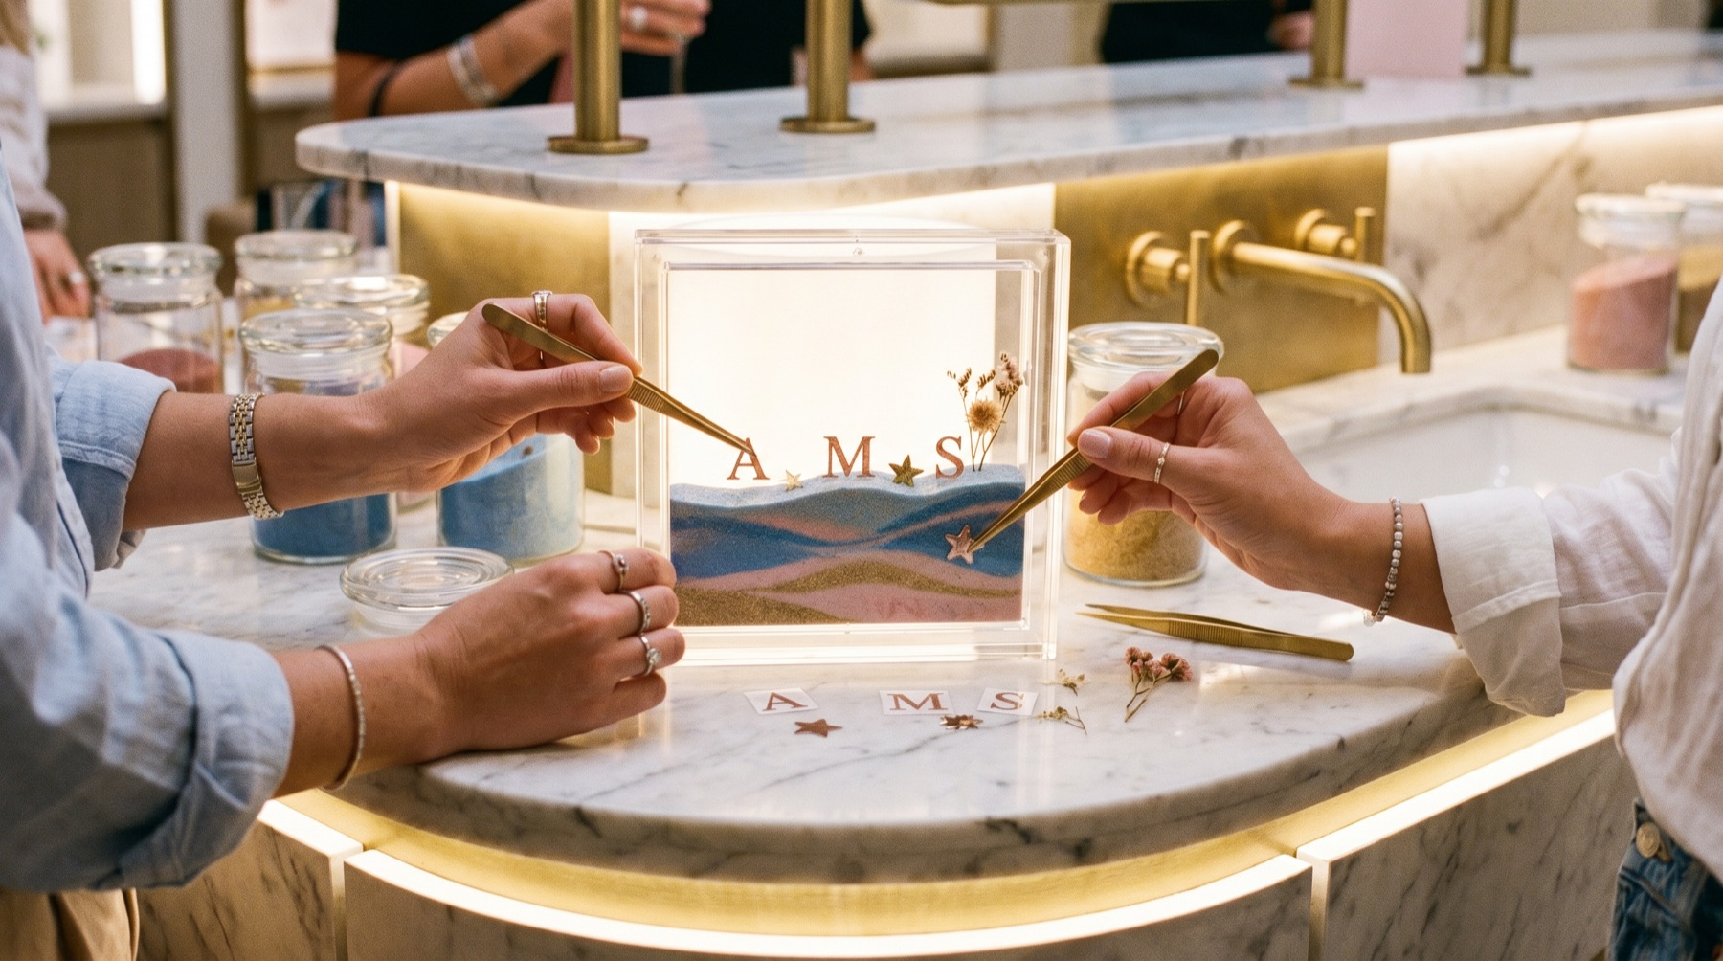
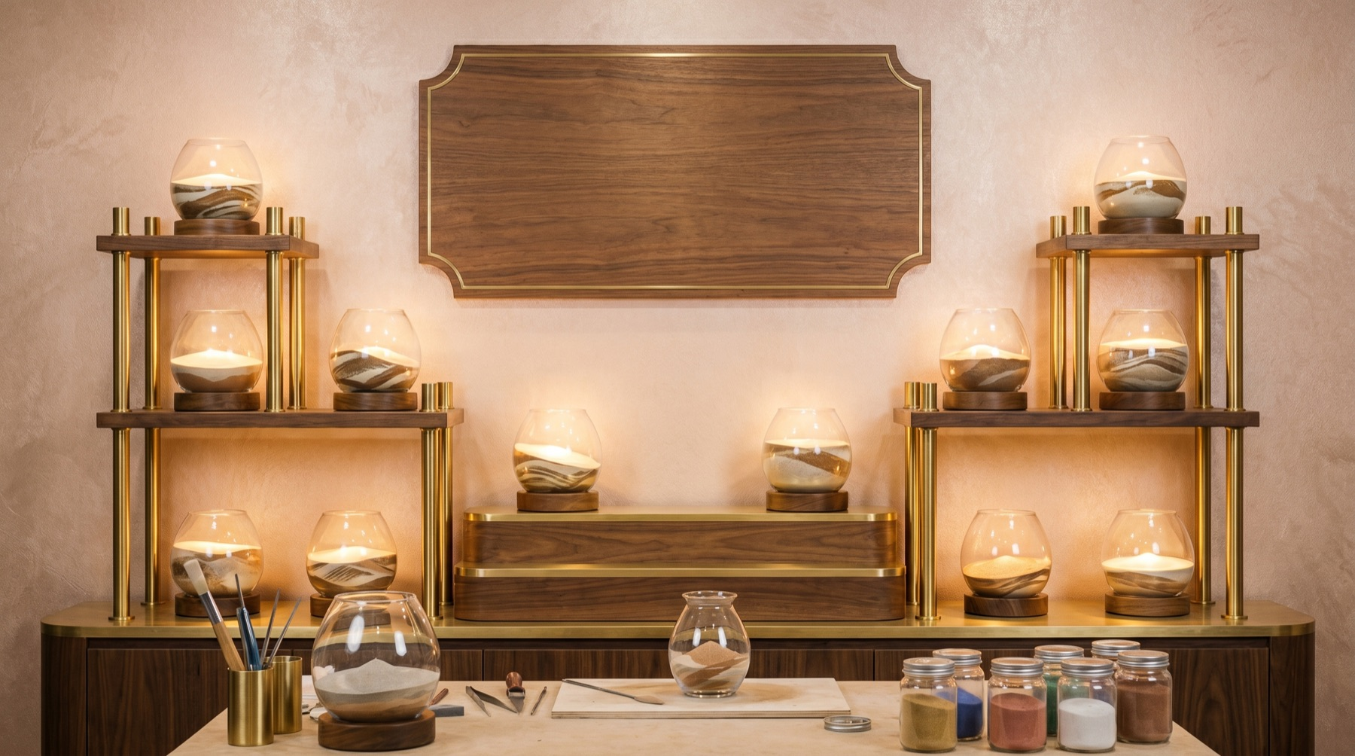
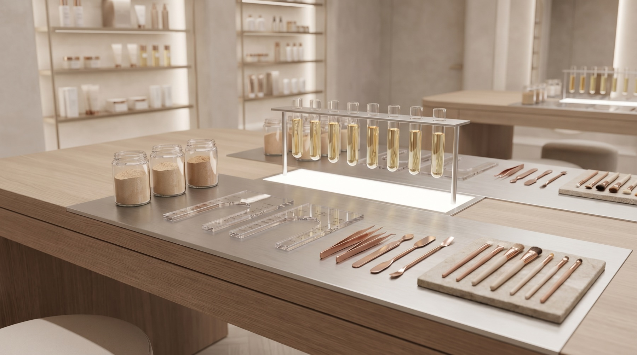
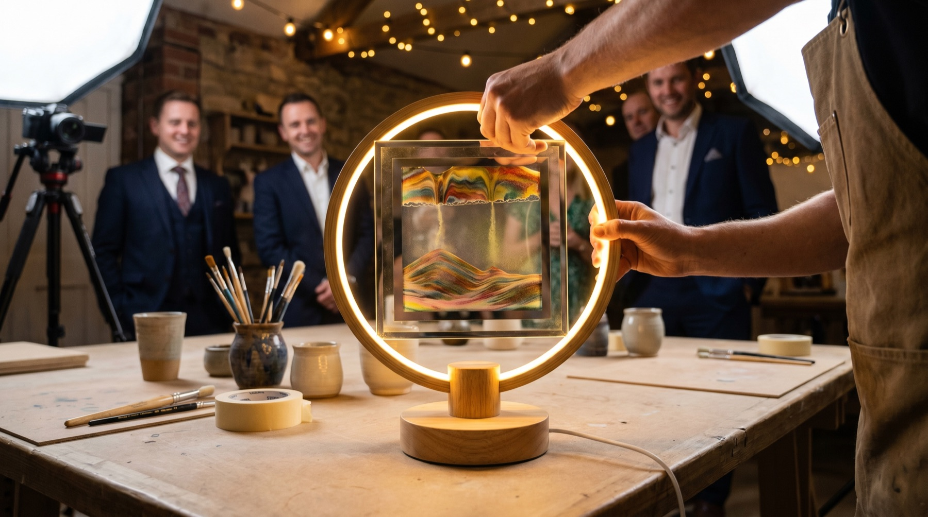
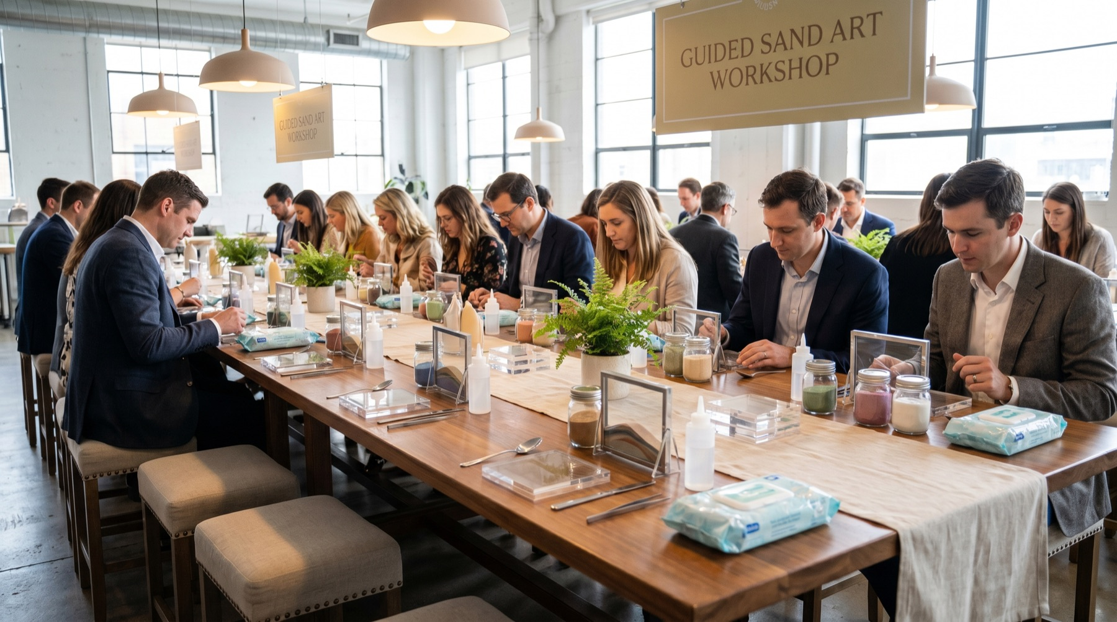
VISUAL DIRECTION
Reference renders — blank panels are intentional (overlay official brand assets)
I-CONCEPT · INTERNAL DRAFT — HUMAN REVIEW REQUIRED

Slide 7
EVENT-ZONE PLAN
Personalised Glow Keepsake Workshop / 專屬閃耀紀念工作坊
Atelier welcome table with rose-g…
Support the route 'Glow Keepsake Atelier / 閃耀紀念工坊' with a concrete guest-faci…
Care-card and packaging moment ex…
Support the route 'Glow Keepsake Atelier / 閃耀紀念工坊' with a concrete guest-faci…
Personalisation workbench where g…
Support the route 'Glow Keepsake Atelier / 閃耀紀念工坊' with a concrete guest-faci…
Glow sample bar comparing illumin…
Support the route 'Crystal Glow Lab / 晶亮光影實驗室' with a concrete guest-facing w…
Illuminated reveal display showin…
Support the route 'Glow Keepsake Atelier / 閃耀紀念工坊' with a concrete guest-faci…
Colour and texture lab with label…
Support the route 'Crystal Glow Lab / 晶亮光影實驗室' with a concrete guest-facing w…
I-CONCEPT · INTERNAL DRAFT — HUMAN REVIEW REQUIRED

Slide 8
BEFORE CLIENT USE
Human review required
VERIFY
☐ Brand claim verification (e.g. nutrition/medical claims) before any e…
☐ Official brand assets / logos / approved product imagery
☐ Approved output format (Canva / Google Slides / PPTX / PDF)
☐ Human review + sign-off by I-Concept (JJ/Rachel/Lester) before client…
☐ From brief: Fields marked TBC need client confirmation
☐ Official Charlotte Tilbury brand guidelines, logos, approved colours…
NEXT DECISION
Which direction should we sharpen into the full pitch?
A · Glow Keepsake Atelier / 閃耀紀念工坊
B · Crystal Glow Lab / 晶亮光影實驗室
C · Initials & Icons Gift Bar / 專屬字母禮物吧
I-CONCEPT · INTERNAL DRAFT — HUMAN REVIEW REQUIRED

